Slide 1
Vadym
Yaremenko
Parallel and Client-Server Programming

Slide 2
Course rules and gradings
Programming Paradigms

Slide 3
Object-Oriented Programming and Design
Grading Policy
Task | Points
Programming task 1 | 10
Programming task 2 | 10
Programming task 3 | 10
Programming task 4 | 10
Programming task 5 | 10
Programming task 6 | 10
Test | 15
Class work (up to 1 point/lesson): | 10
Final exam | 15
Total | 100

Slide 4
Object-Oriented Programming and Design
Deadlines and number of lessons
Week start | 6 Jan | 13 Jan | 20 Jan | 27 Jan | 3 Feb | 10 Feb | 17 Feb | 24 Feb | 3 Mar | 10 Mar | 17 Mar
Asmt1 |  | 10 | 8 | 6 | 0
Asmt2 |  |  |  | 10 | 8 | 6 | 0
Asmt3 |  |  |  |  | 10 | 8 | 6 | 0
Asmt4 |  |  |  |  |  | 10 | 8 | 6 | 0
Asmt5 |  |  |  |  |  |  | 10 | 8 | 6 | 0
Asmt6 |  |  |  |  |  |  |  |  | 10 | 8 | 0
Extra | 10
Test |  |  |  |  |  | 15
Final |  |  |  |  |  |  |  |  |  |  | 15

Slide 5
Object-Oriented Programming and Design
Materials
An Introduction to Computer Networks¶ by P. L. Dordal 2020 http://intronetworks.cs.luc.edu/current1/ComputerNetworks.pdf
C++ Concurrency in Action A. Williams 2012 https://www.bogotobogo.com/cplusplus/files/CplusplusConcurrencyInAction_PracticalMultithreading.pdf
Game Engine Architecture 3rd edition 2018 by Jason Gregory – Chapter 4 Official OS and C++ documentation.
https://learn.microsoft.com
https://cplusplus.com/

Slide 6
Introduction
Fundamentals of Communication and Networking

Slide 7
Fundamentals of Communication and Networking
Concurrent programming
Is a form of computing in which several computations are executed concurrently - during overlapping time periods - instead of sequentially - with one completing before the next starts.
// A classic example with cash withdrawal problem
// Assume that we have 2 parallel calls withdraw(250) and the balance is 500
bool withdraw(int withdrawal)
{
if (balance >= withdrawal)
{
balance -= withdrawal;
return true;
}
return false;
}

Slide 8
Fundamentals of Communication and Networking
Concurrent programming
A concurrent piece of software utilizes multiple flows of control to solve a problem. These flows of control might be implemented as multiple threads running within the context of a single process, or multiple cooperating processes running either on a single computer or multiple computers.

Slide 9
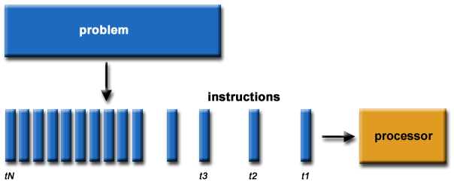
Fundamentals of Communication and Networking
Sequential execution

Slide 10

Fundamentals of Communication and Networking
Concurrent execution

Slide 11
Fundamentals of Communication and Networking
Parallelism
In computer engineering, the term parallelism refers to any situation in which two or more distinct hardware components are operating simultaneously. In other words, parallel computer hardware can perform more than one task at a time. In contrast, serial computer hardware is capable of doing only one thing at a time.

Slide 12






Fundamentals of Communication and Networking
Concurrent processes

Slide 13
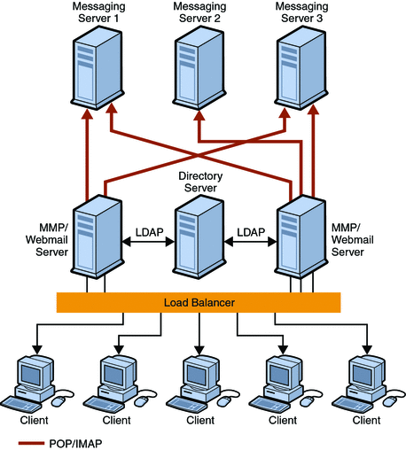
Fundamentals of Communication and Networking
Example of client-server architecture

Slide 14
Fundamentals of Communication and Networking
Types of parallelism
Task
Data
Algorithms
Instructions

Slide 15
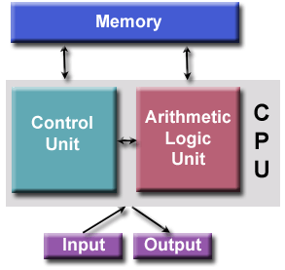
Fundamentals of Communication and Networking
Von Neumann Architecture
Most computers are built on this architecture4 components (memory, control device, arithmetic-logic device, information input-output system).
The data and instruction set are stored in memory.
The control device takes instructions and data from memory, decodes them and sequentially forwards them to the ALPALP performs basic arithmetic operations.
An input-output system is necessary for interaction with a human operator

Slide 16
Fundamentals of Communication and Networking
Flynn’s taxonomy
The space is thus divided into four quadrants:
• Single instruction, single data (SISD): A single instruction stream operating on a single data stream.
• Multiple instruction, multiple data (MIMD): Multiple instruction streams operating on multiple independent data streams.
• Single instruction, multiple data (SIMD): A single instruction stream operating on multiple data streams (i.e., performing the same sequence of operations on multiple independent streams of data simultaneously)
• Multiple instruction, single data (MISD): Multiple instruction streams all operating on a single data stream. (MISD is rarely used in games, but one common application is to provide fault tolerance via redundancy.)

Slide 17
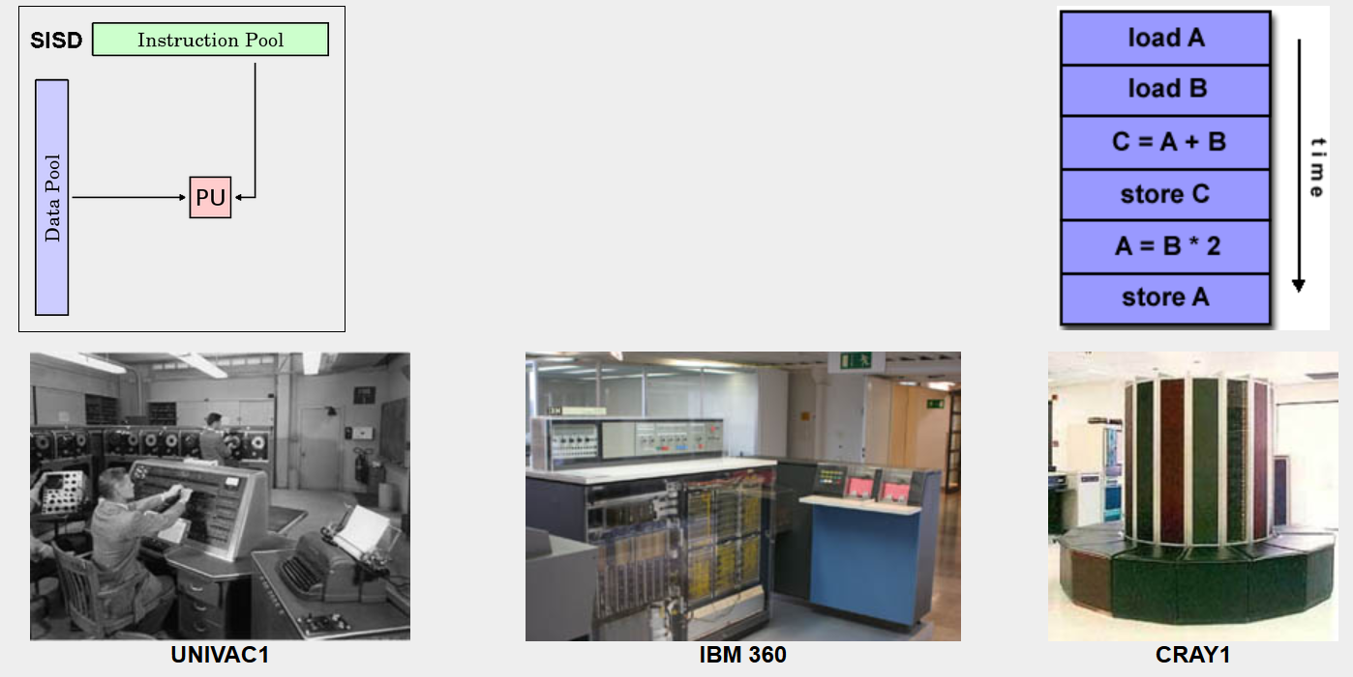
Fundamentals of Communication and Networking
Flynn’s taxonomy: SISD

Slide 18
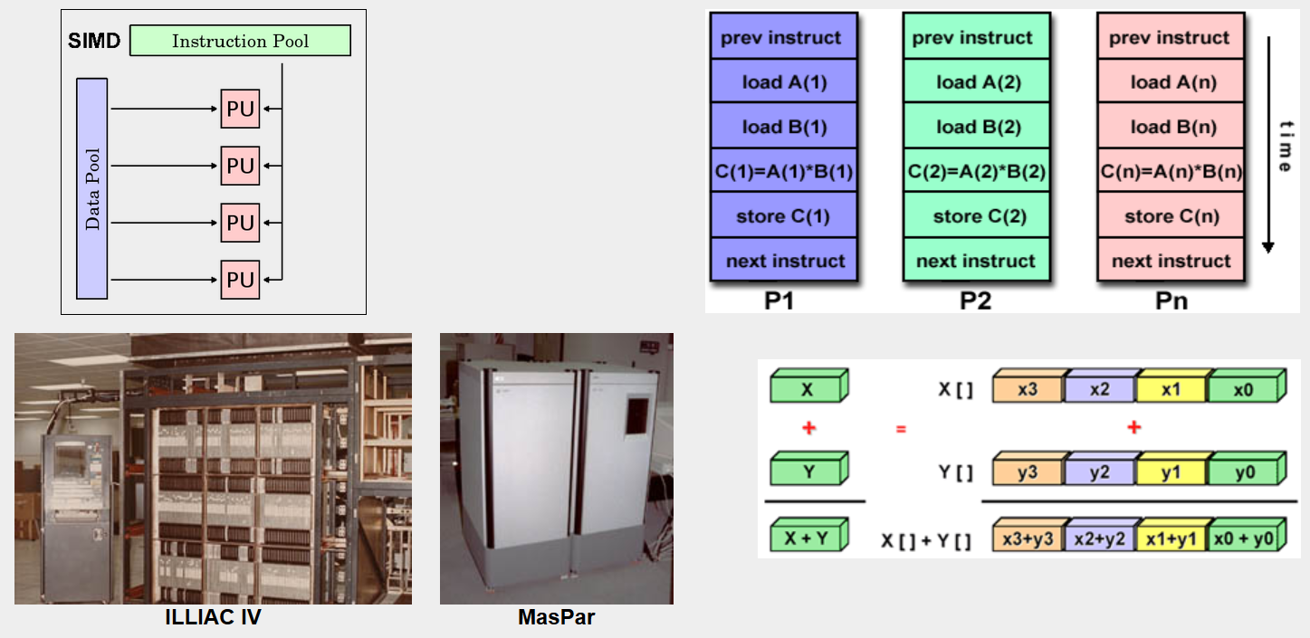
Fundamentals of Communication and Networking
Flynn’s taxonomy: SIMD

Slide 19
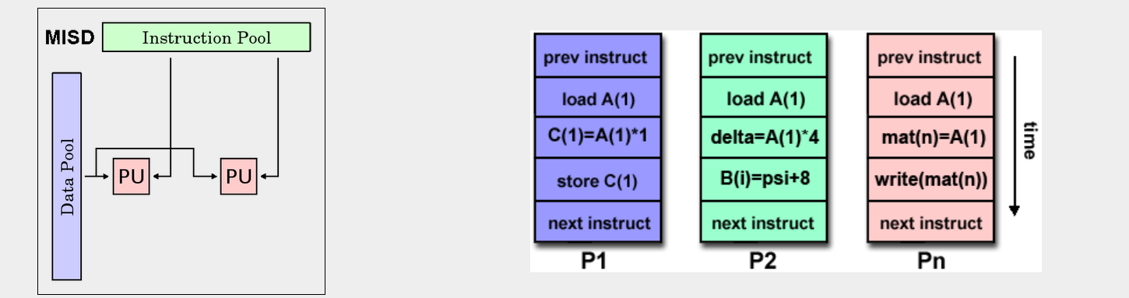
Fundamentals of Communication and Networking
Flynn’s taxonomy: MISD

Slide 20
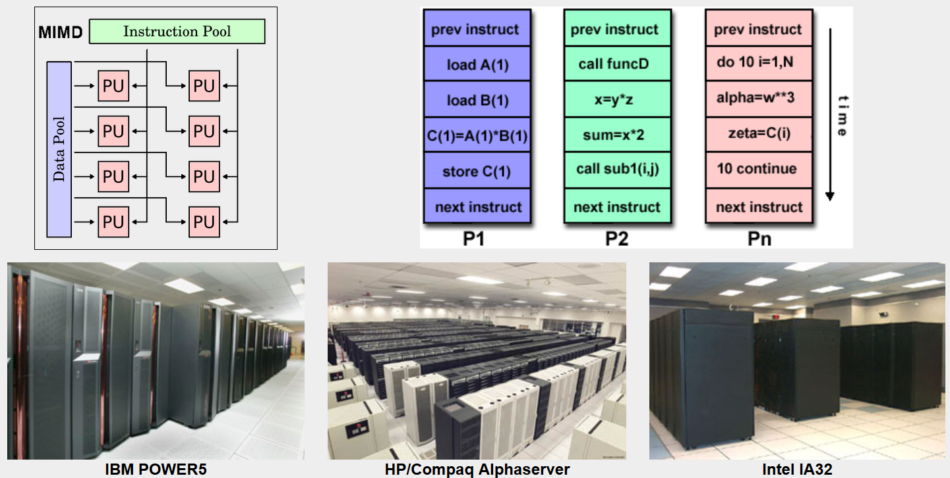
Fundamentals of Communication and Networking
Flynn’s taxonomy: MIMD

Slide 21
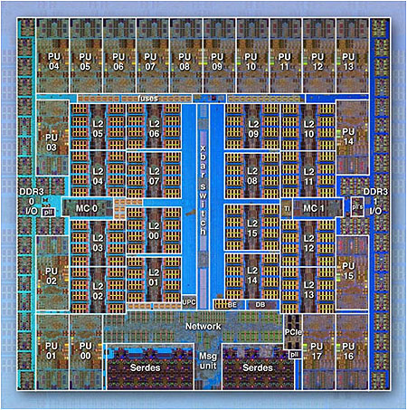
Fundamentals of Communication and Networking
IBM BG/Q Compute Chip

Slide 22
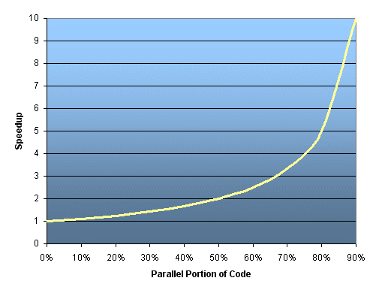

Fundamentals of Communication and Networking
Amdahl’s Law
Speedup $=\frac{1}{P}$
𝑃 is part of the code that are executed sequentially
1 – P is a part of the code that can be executed in parallel

Slide 23
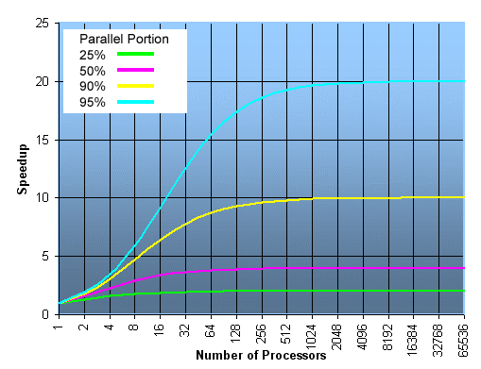

Fundamentals of Communication and Networking
Amdahl’s Law
Speedup $=\frac{1}{\frac{1 − P}{N} + P}$
𝑃 is part of the code that can be executed sequentially
1 – P is a part of the code that can be executed in parallel
N – the number of processors

Slide 24
Fundamentals of Communication and Networking
Task 1/2
Implement a program to find a sum of the elements in the array.

Slide 25
Fundamentals of Communication and Networking
Task 2/2
Speedup the program.

Slide 26
Operating Systems API
Fundamentals of Communication and Networking

Slide 27
Fundamentals of Communication and Networking
Layer Diagram
Application level
Operating System
Hardware

Slide 28
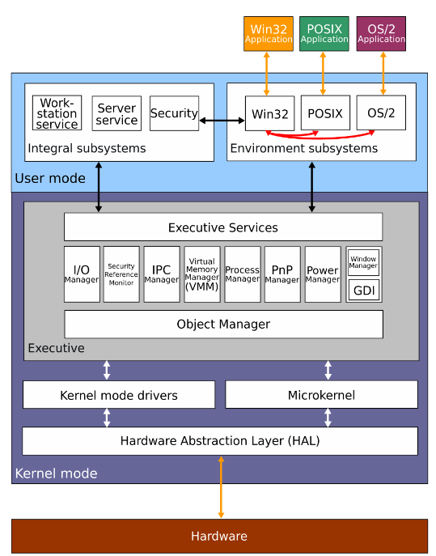
Fundamentals of Communication and Networking
OS Architecture

Slide 29
Fundamentals of Communication and Networking
Program Thread
A thread is an entity in the operating system that is created to execute a sequential set of instructions (program code) on the CPU.
It is the smallest unit of processing that can be assigned to the operating system (OS) kernel.
The general purpose of threads is the parallel execution of two or more different tasks on the processor.
Threads were the first step towards multitasking OS.
The scheduler of the OS, guided by the priority of the thread, distributes time quanta between different threads and sets the threads to execution.

Slide 30
Fundamentals of Communication and Networking
Program Process
A process is an abstraction that encapsulates different types of resources: open files, memory-mapped files and their descriptors, streams, etc. The process can be thought of as an instance of a running program.
Each process has at least one thread.
Also, each process has its own virtual address space and execution context, and threads of the same process share the process's address space.
Each process is an independent object for which such system resources as processor time, memory, etc. are allocated.
Each process runs in a separate address space.
If we want to access the resources of another process, we must use interprocess communication tools such as pipes, files, sockets, etc.

Slide 31
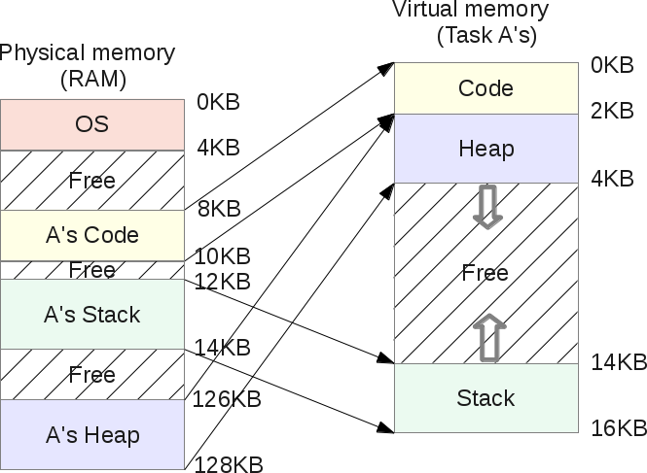
Fundamentals of Communication and Networking
Process Virtual Memory

Slide 32
Fundamentals of Communication and Networking
Process & Thread Relationship
A thread uses the same address space as a process.
A process can have multiple threads.
As a rule, several threads can read from the same memory and write it to the same memory (no process can directly access the memory of another process).
However, each thread still has its own stack of activation records and its own copy of the CPU registers, including the stack pointer and program counter, which together describe the thread's execution state.

Slide 33
Fundamentals of Communication and Networking
Windows API for Creating Processes
Library #include <windows.h>
BOOL CreateProcessA(
LPCSTR lpApplicationName,
LPSTR lpCommandLine,
LPSECURITY_ATTRIBUTES lpProcessAttributes,
LPSECURITY_ATTRIBUTES lpThreadAttributes,
BOOL bInheritHandles,
DWORD dwCreationFlags,
LPVOID lpEnvironment,
LPCSTR lpCurrentDirectory,
LPSTARTUPINFOA lpStartupInfo,
LPPROCESS_INFORMATION lpProcessInformation
);

Slide 34
Fundamentals of Communication and Networking
Windows API for Creating Threads
Library #include <windows.h>
HANDLE CreateThread(
LPSECURITY_ATTRIBUTES lpThreadAttributes,
SIZE_T dwStackSize,
LPTHREAD_START_ROUTINE lpStartAddress,
__drv_aliasesMem LPVOID lpParameter,
DWORD dwCreationFlags,
LPDWORD lpThreadId
);

Slide 35
Fundamentals of Communication and Networking
Linux API for Creating Processes
#include <unistd.h>
#include <stdio.h>
int main (void)
{
pid_t p; // fork returns type pid_t
p = fork();
printf("fork returned %d\n", p);
return 0;
}
sunbox$ gcc fork1.c -o fork1
sunbox$ ./fork1
fork returned 0
fork returned 698

Slide 36
Fundamentals of Communication and Networking
Linux API for
Creating Threads
#include<pthread.h>
#include<stdio.h>
// compile with -lpthreads
// create the function to be executed as a thread
void* thread(int a)
{
printf(“%d”, a);
}
int main(int argc, char **argv)
{
// create the thread objs
pthread_t thread1;
int thr = 1;
// start the threads
pthread_create(&thread1, NULL, *thread, (void *)thr);
// wait for threads to finish
pthread_join(thread1, NULL);
return 0;
}

Slide 37
Fundamentals of Communication and Networking
OS Kernel Mode
In operating systems, the kernel controls the entire running system and knows everything about it, unlike a process.
When a program executes, the kernel loads the program code into virtual memory, allocates space for program variables, and sets up kernel accounting data structures to record various information (such as process ID, completion status, user ID, and group ID) about the process.

Slide 38
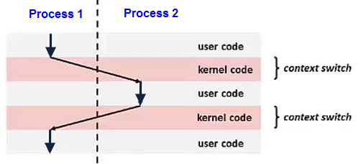
Fundamentals of Communication and Networking
OS Kernel Mode
Switching the CPU from one process or thread to another is called a context switch.
This requires saving the state of the old process or thread and loading the state of the new one.
Since there can be hundreds of context switches per second, context switches can potentially add significant resource (time) overhead to execution.

Slide 39
Synchronization
Fundamentals of Communication and Networking

Slide 40
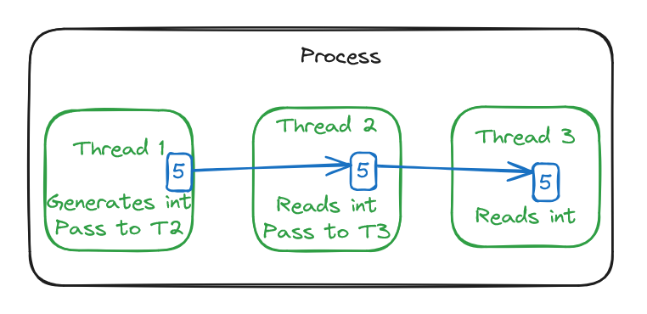
Fundamentals of Communication and Networking
Task
Implement a program with 3 threads that share an integer value and pass it from one to another.

Slide 41
Fundamentals of Communication and Networking
Exercise: what is the output?
#include <iostream>
#include <thread>
int counter = 0;
void increment() {
for (int i = 0; i < 1000000; i++) {
counter++;
}
}
int main() {
std::thread t1(increment);
std::thread t2(increment);
t1.join();
t2.join();
std::cout << "Counter value: " << counter << std::endl;
return 0;
}

Slide 42
Fundamentals of Communication and Networking
Race condition
This is an error in the design of a parallel (distributed) system, in which the operation of the system depends on the order in which parts of the program code are executed.
This situation got its name from a similar error in the design of electronic circuits.
Thread 1 | Thread 2 | Thread 3
Read Х
Х = Х + 1 | Read Х | Read Х
Write Х | Х = Х + 2
 | Write Х | Х = Х + 3
 |  | Write Х
Time

Slide 43
Fundamentals of Communication and Networking
Exercise: what is the output?
#include <iostream>
#include <thread>
int counter = 0;
void increment() {
for (int i = 0; i < 1000000; i++) {
counter++;
}
}
int main() {
std::thread t1(increment);
std::thread t2(increment);
t1.join();
t2.join();
std::cout << "Counter value: " << counter << std::endl;
return 0;
}

Slide 44
Fundamentals of Communication and Networking
Deadlock
Deadlock is a situation in which no thread in the system can make progress, resulting in a hang.
When a deadlock occurs, all threads are in their Blocked states, waiting on some resource to become available. But because no threads are Runnable, none of those resources can ever become available, so the entire program hangs.
Actually, a cycle in the dependency graph isn’t quite enough to produce a deadlock. Strictly speaking, there are four necessary and sufficient conditions for deadlock, known as the Coffman conditions [paragraph 4.7.1, GAA]:
Mutual exclusion
Hold and Wait
No lock preemption
Circular wait

Slide 45
Fundamentals of Communication and Networking
Principles for the development of parallel programs
The proof of the correctness of the obtained results should be carried out for any possible temporal relations for the elements of the temporal trajectories of threads;
In order to exclude the dependence of program execution results on the sequence of commands of different threads, it is necessary to analyze the situations of mutual influence of threads on the shared data and develop methods for their exclusion;
There is a significant increase in the complexity of parallel programming compared to the development of "traditional" sequential programs;
It should be noted that in the most general case, a parallel program can be a set of processes, each of which can consist of several threads.

Slide 46
Fundamentals of Communication and Networking
Atomicity
An atomic operation is a sequence of operations that appears to the rest of the system as if it were executed instantaneously and sequentially, without any other operations occurring in between.
This is important because in a parallel program, multiple threads or processes may access the same shared data simultaneously, which can lead to race conditions and data inconsistencies.
Atomic operations provide a way to synchronize access to shared data and ensure that they are modified in a correct and predictable manner.
Don’t confuse yourself when comparing Atomicity and `Atomic Variables` that will be discussed later in this course.

Slide 47
Fundamentals of Communication and Networking
Atomicity
Some common examples of atomic operations include read-modify-write operations (e.g., incrementing a shared counter) and compare-and-swap operations (e.g., updating a shared variable only if its value matches a given value). These operations can be implemented using hardware support (such as atomic instructions in modern processors) or software synchronization primitives (such as locks or semaphores).

Slide 48
Fundamentals of Communication and Networking
Synchronization primitives in standard C++
std::mutex: A mutex is a synchronization primitive that can be used to protect shared data from concurrent access. It provides a way to lock a shared resource so that only one thread can access it at a time.
std::recursive_mutex: A recursive mutex is similar to a mutex, but it allows the same thread to lock and unlock the mutex multiple times without causing a deadlock.
std::condition_variable: A condition variable is a synchronization primitive that can be used to block a thread until a specific condition is met. It allows a thread to wait for a signal from another thread before continuing execution.

Slide 49
Fundamentals of Communication and Networking
Synchronization primitives in standard C++
std::atomic: An atomic variable is a type of variable that can be accessed atomically, without the need for locks or other synchronization primitives. It provides a way to perform simple operations, such as incrementing a counter, in a thread-safe manner.
std::atomic_flag: An atomic flag is a type of variable that can be used to implement a spinlock. It provides a way to perform simple operations, such as setting and clearing a flag, in a thread-safe manner.
std::once_flag: A once flag is a synchronization primitive that can be used to ensure that a specific function is called only once, regardless of how many threads try to call it.

Slide 50
Fundamentals of Communication and Networking
Synchronization primitives in standard C++
std::lock_guard: A lock guard is a class that can be used to acquire and release a mutex automatically. It provides a way to ensure that a mutex is released when a block of code is exited, even if an exception is thrown.

Slide 51
Fundamentals of Communication and Networking
Mutex
A mutex (short for mutual exclusion) is a synchronization primitive that allows multiple threads to access a shared resource in a mutually exclusive manner. Its purpose is to ensure that only one thread can access the shared resource (e.g., a critical section of code, a shared variable, or a shared data structure) at a time, while all other threads are blocked until the mutex is released.
In C++, a mutex can be created using the std::mutex class, which provides two main methods: lock() and unlock().

Slide 52
Fundamentals of Communication and Networking
#include <iostream>
#include <thread>
#include <mutex>
std::mutex mtx; // create a mutex
int counter = 0;
void increment() {
for (int i = 0; i < 1000000; i++) {
mtx.lock(); // acquire the lock
counter++;
mtx.unlock(); // release the lock
}
}
int main() {
std::thread t1(increment);
std::thread t2(increment);
t1.join();
t2.join();
std::cout << "Counter value: " << counter << std::endl;
return 0;
}
Mutex

Slide 53
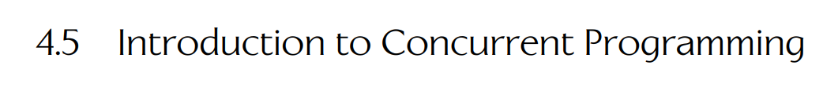
Fundamentals of Communication and Networking
Homework
Read section 4.5 in Game Engine Development:

Slide 54
Fundamentals of Communication and Networking
RAII for std::lock_guard
Task: implement a RAII mechanism to control mutex releasing.
#include <mutex>
class MutexRAII {
public:
MutexRAII(std::mutex& mutex) : mutex_(mutex) {
mutex_.lock();
}
~MutexRAII() {
mutex_.unlock();
}
private:
std::mutex& mutex_;
};

Slide 55
Fundamentals of Communication and Networking
Monitors
A monitor is a term that refers to an object whose methods can be used safely in a parallel environment.
When one of the monitor methods is executed, all other attempts to call other methods of the same monitor are blocked.
Enforcement of such a rule must be implemented by a runtime that supports the concept of monitors.

Slide 56
Fundamentals of Communication and Networking
Monitors
In addition to interlocking methods, another important property of the monitor is its isolation from other parts of the program code:
Monitor variables are not accessible outside of it and can only be handled by monitor methods;
Only monitor methods are available outside the monitor;
Variables declared outside the monitor are not accessible inside.
Such localization (encapsulation) and unification within the monitor of all critical sections of threads leads to a significant reduction in the complexity of parallel execution logic.

Slide 57
Fundamentals of Communication and Networking
Monitors
In some cases, monitor methods may need to terminate (block) the executing thread until some condition is met.
To solve such problems, an additional mechanism of conditional variables is introduced in the monitors.

Slide 58
Fundamentals of Communication and Networking
Condition variables
Conditional variables are objects of the special type, which are used to organize the suspension of the flow until certain logical conditions are met.
Actions with conditional variables are carried out with the help of two main operations:
wait (cv) - the operation of waiting for the occurrence of an event; at the same time, for the thread that performed this operation, the lock is removed, and the monitor procedures again become available for use (despite the fact that the procedures terminated by the wait operation have not yet completed their execution);
signal (cv) - operation to announce the occurrence of an event; as a result of this operation, one of the threads waiting for this event becomes ready to continue (if there are no threads waiting for this event, the event signal is lost).

Slide 59
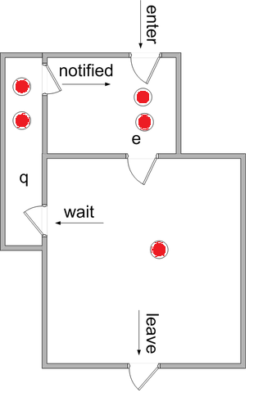
Fundamentals of Communication and Networking
Monitors: wait-notify mechanism
A Thread

Slide 60
Fundamentals of Communication and Networking
Monitors: one more explanation
A monitor is like a building that contains one special room that can be occupied by only one thread at a time. The room usually contains some data. From the time a thread enters this room to the time it leaves, it has exclusive access to any data in the room. Entering the monitor building is called "entering the monitor." Entering the special room inside the building is called "acquiring the monitor." Occupying the room is called "owning the monitor," and leaving the room is called "releasing the monitor." Leaving the entire building is called "exiting the monitor.“

Slide 61
Fundamentals of Communication and Networking
Monitors in C++: Condition variables
Official link: https://cplusplus.com/reference/condition_variable/condition_variable/
Example is in “Example C++ Monitor.docx” file.

Slide 62
Fundamentals of Communication and Networking
Monitors in Java
Official link: https://docs.oracle.com/javase/8/docs/api/java/lang/Object.html
Read about notify, notifyAll and wait methods.

Slide 63
Fundamentals of Communication and Networking
Monitors in C#
Official link: https://learn.microsoft.com/en-us/dotnet/api/system.threading.monitor?view=net-8.0

Slide 64
Fundamentals of Communication and Networking
Classical synchronization problems
Bound-Buffer problem (Consumers-Producers)
Sleeping barber problem
Dining Philosophers problem
Readers and writers problem

Slide 65
Fundamentals of Communication and Networking
Bound-Buffer problem (Consumers-Producers)
Producer
Consumer
Bound-Buffer
Producer
Consumer
Producer

Slide 66



Fundamentals of Communication and Networking
The task is as follows:
the barber should sleep when there are no customers
the barber must work when there are customers
customers must be served on a first-come, first-served basis
the number of waiting places is limited
Sleeping barber problem

Slide 67

Fundamentals of Communication and Networking
Dining Philosophers problem
Five philosophers are sitting at a round table who do not communicate with each other.
There is a plate of spaghetti in front of everyone, and there are five forks on the table: one to the left and one to the right of the plate.
Every philosopher can either eat or think at a certain point in time.
To eat, the philosopher needs to have two forks while eating (an alternative version of the problem describes Chinese chopsticks).

Slide 68
Fundamentals of Communication and Networking
Readers-writers problem
Writer
Reader
Shared memory
Writer
Reader
Writer

Slide 69
Fundamentals of Communication and Networking
Disadvantages of traditional locks
Traditional locks, such as std::mutex, typically (depending on OS implementation) rely on a combination of atomic operations, such as compare-and-swap, and kernel-level synchronization primitives, such as semaphores, to ensure that only one thread can access a critical section of code at a time.
While this approach is generally effective, it can be slower than using atomic variables, especially in cases where contention is high and threads frequently need to wait for access to the critical section.

Slide 70
Fundamentals of Communication and Networking
Atomic operations
Atomic variables, on the other hand, use hardware-supported atomic operations to ensure that read-modify-write operations on the variable are performed atomically, without the need for additional synchronization overhead.
This means that multiple threads can safely read and write to the same atomic variable without the need for locks or other synchronization primitives.

Slide 71
Fundamentals of Communication and Networking
Atomic Variables: Compare-Exchange
One common atomic operation used in many atomic variable implementations is the cmpxchg (compare and exchange) instruction, which is a processor-level instruction that is provided by many modern CPUs.
The cmpxchg instruction takes two operands, a memory location and a register value, and performs the following operations:
Compares the value in the memory location with the value in the register.
If the values are equal, the register value is written to the memory location.
If the values are not equal, the value in the memory location is loaded into the register.

Slide 72
Fundamentals of Communication and Networking
Atomic Variables: Compare-Exchange
Atomic variables can be faster than traditional locks because they avoid the overhead of additional synchronization primitives, and can take advantage of hardware-supported atomic operations to perform updates more efficiently.

Slide 73
Fundamentals of Communication and Networking
Atomic Variables: Disadvantages
Limited functionality: Atomic variables can only perform a limited set of operations, such as load, store, add, subtract, etc.
Complex operations like mutexes or semaphores are not available with atomic variables.
Additionally, not all data types can be made atomic, and even for those that can, the overhead of the atomic operations can be significant for large or complex data structures.

Slide 74
Fundamentals of Communication and Networking
Atomic Variables: Base Example in C++
#include <iostream>
#include <atomic>
#include <thread>
std::atomic<int> counter(0); // Declare atomic variable
void increment_counter(int n)
{
for (int i = 0; i < n; i++)
{
int expected = counter.load();
while (!counter.compare_exchange_weak(expected, expected + 1)) {
// If the compare-exchange fails, update the expected value and try again
expected = counter.load();
}
};
}
int main()
{
const int num_threads = 10;
const int num_iterations = 10000;
std::thread threads[num_threads];
for (int i = 0; i < num_threads; i++) {
threads[i] = std::thread(increment_counter, num_iterations);
}
for (int i = 0; i < num_threads; i++) {
threads[i].join();
}
std::cout << "Final value of counter: " << counter << std::endl;
return 0;
}

Slide 75
Fundamentals of Communication and Networking
Atomic Variables: Example in C++
int main()
{
const int num_threads = 10;
const int num_iterations = 10000;
std::thread threads[num_threads];
for (int i = 0; i < num_threads; i++) {
threads[i] = std::thread(increment_counter, num_iterations);
}
for (int i = 0; i < num_threads; i++) {
threads[i].join();
}
std::cout << "Final value of counter: " << counter << std::endl;
return 0;
}
#include <iostream>
#include <atomic>
#include <thread>
std::atomic<int> counter(0); // Declare atomic variable
void increment_counter(int n)
{
for (int i = 0; i < n; i++) {
counter++; // Atomic increment operation
}
}

Slide 76
Fundamentals of Communication and Networking
Future-Promise Mechanism
The future-promise mechanism in C++ provides a powerful way to handle asynchronous operations and manage the flow of execution in a concurrent program.
The basic idea is that one thread can create a promise object to represent a value that will be computed in the future, while another thread can create a future object to represent the result of that computation.

Slide 77
Fundamentals of Communication and Networking
Future-Promise Mechanism
The benefit of the future-promise mechanism is that it provides a way to communicate between threads without the need for explicit synchronization.
When you create a promise object and a future object, the two objects are associated with each other, so the future object can be used to retrieve the result of the computation when it's available.
The promise object is used to set the value of the result when it's ready, and the future object can be used to wait for the result or to check if it's available yet.

Slide 78
Fundamentals of Communication and Networking
Future-Promise Mechanism: Example in C++

Slide 79
Fundamentals of Communication and Networking
std::async
std::async is a C++ Standard Library function that allows you to launch a function asynchronously and obtain a std::future object that represents the result of the function call.
The function is defined in the <future> header and is a part of the concurrency specification.

Slide 80
Fundamentals of Communication and Networking
Future-Promise Mechanism with std:async

